Slide 1

Supermarket data analysis
Chen Alfasi
Link:

Slide 2
AGENDA
Introduction​
Data set
​Methodology
Observations
Insights & Recommendations

Slide 3
Introduction
In this project, I will analyze data from a supermarket chain in India. The data includes information on each sale during 2019. The analysis, the queries, and the visualization will be performed by MYSQL and Power BI to obtain business insights.

Slide 4
Data set
My data set includes the following data:
Invoice ID, Branch, City, Customer type, Gender, Product line, Unit price, Quantity, Total, Date, Time, Payment type, Total with & and without tax of 5%, and Rating.

Slide 5
Methodology
My analysis and examination focused on the following parameters:
1. Quarter and months. 2. Supermarket’s Branches. 3. Product line.
4. Gender.
5. Payment type. I performed the analysis to understand which products are the most profitable and have high ratings from the customers to continue selling these products, and at the same time understand which products should be taken off the shelves.
In addition, I tried to determine which branch is the most profitable and has a high rating, while in the branches with a low rating, we will invest effort to increase profitability and customer satisfaction.
Beyond that, I also analyzed the data by month and quarter to check if there is any trend, if customer satisfaction has increased or decreased, and if the supermarket's profits have increased or decreased.

Slide 6
Observations
Analysis by Chain
Analysis by Branches

Slide 7
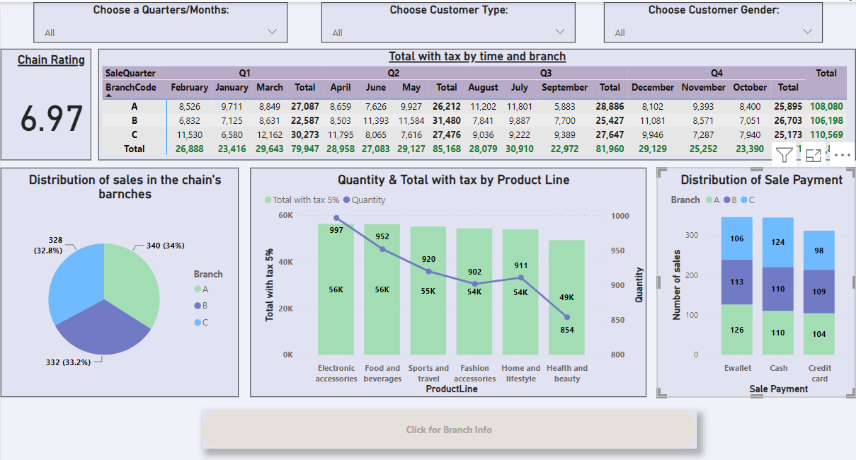
Analysis by CHAIN

Slide 8
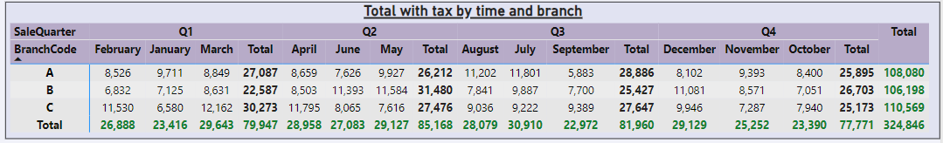
Analysis by CHAIN

Slide 9
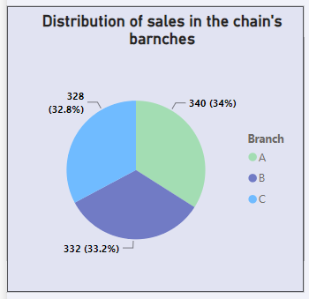
Analysis by CHAIN

Slide 10
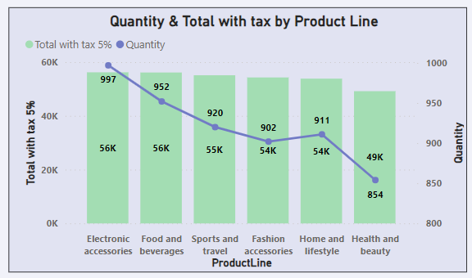
Analysis by CHAIN

Slide 11
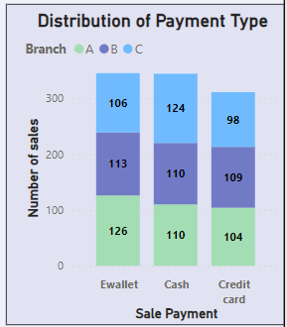
Analysis by CHAIN

Slide 12
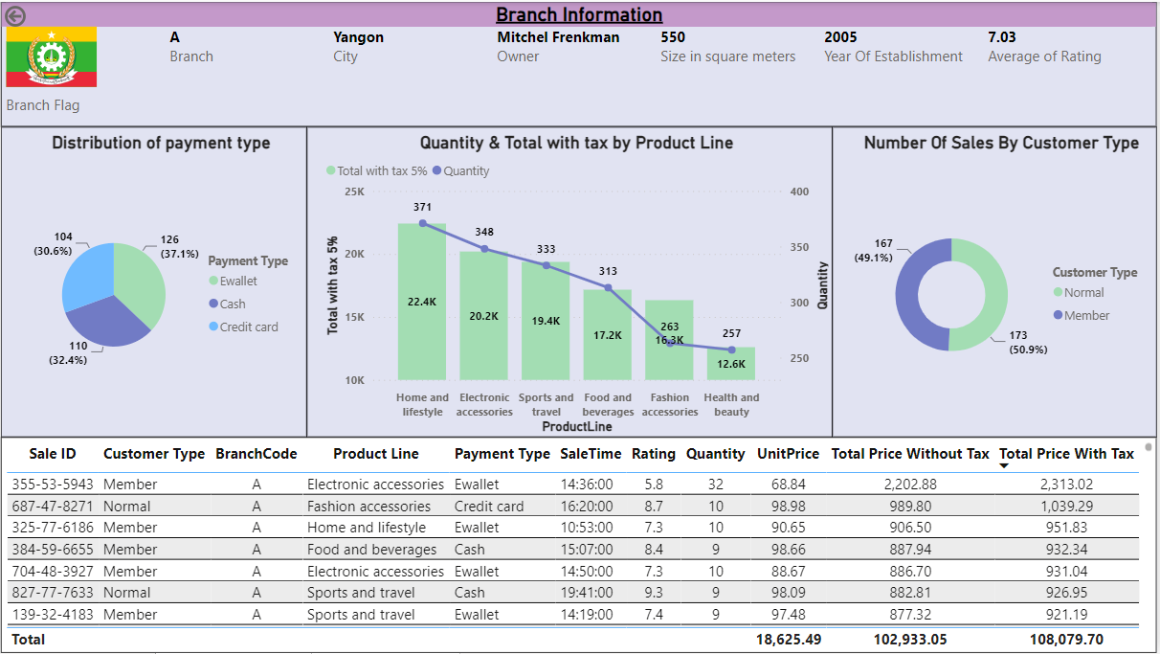
Analysis by Branches

Slide 13
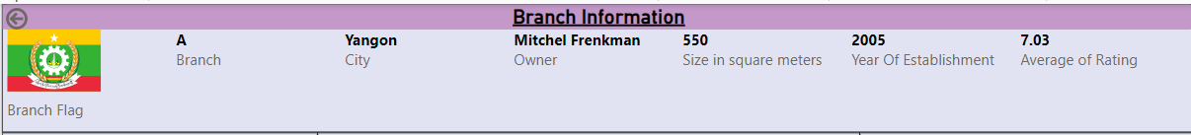
Analysis by Branches

Slide 14
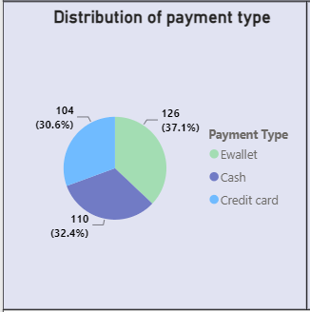
Analysis by Branches
In this Pie Chart, we can see the distribution of payment type in a specific branch, in this case, we can see almost a uniform distribution in branch A.

Slide 15
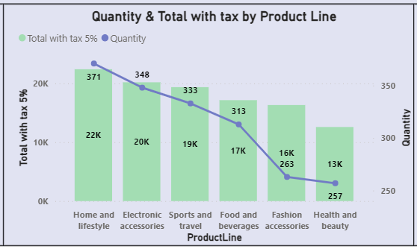
Analysis by Branches
In this Line stacked and column chart, we can see the total sales and the quantity for each product line in Branch A. The most successful product is Home and Lifestyle, and the most unsuccessful is Health and Beauty – like in the chain.
In addition, there is a tooltip that brings additional summary for each Product line like rating, etc.

Slide 16
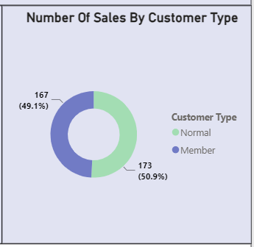
Analysis by Product Type
In this Donut chart, we can see the number and the percentage of the sales by customer type in branch A. As we can see they are quite equal.

Slide 17
Insights & Recommendations

Slide 18
In all branches over 60 percent of purchases are made using credit cards and EWallet. This is a reason why it is worthwhile to increase the number of digital cash registers and simultaneously reduce the number of cashiers in branches. This will lead to the reduction of expenses and queues in the branches, which may increase the rating and profitability.
The second quarter is the chain's most profitable, as expected. And this is because this is the summer period in India when more people leave the house to hang out and shop. I recommend doing a marketing campaign this quarter and lowering prices a little to attract more customers to become club members and thus win them for the rest of the year, which will lead to increased profitability in the other quarters as well.
There is no direct relationship between the number and the total sale of the product lines sold in the chain compared to the branches, also there is no direct relationship between the branches in this aspect, except Healthy and Beauty – the unsuccessful product line in all the branches. Therefore, this does not mean that the level of success of the product lines in the chain will be at the same level in every branch. In this case, I would recommend increasing the types of products from that successful product line in the branch to increase profitability because customers are interested in purchasing products from this product line. And do the opposite for the unsuccessful product lines in the branch. For example: in branch A I would sell more new products from Home and Lifestyle In branch B and C I would sell more new products from Food and beverages.

Slide 19
The size of the branches is different, however, the total of sales and the average rating are similar. Therefore, if there is a consideration to open a new branch, then it is better to open a branch the size of branch A - 550 square meters and thus increase profitability by reducing the rent.

Slide 20
THANK YOU
Chen Alfasi
Chenalfasi7@gmail.com

